Slide 1

Exploratory Data Analysis on Flipkart
Team Members :
L. Sandhya
L. Thrisha Sai

Slide 2
Problem Statement
The Flipkart platform provides a vast selection of laptops with varying prices, specifications, and ratings, making it challenging for customers and sellers to understand market dynamics. This project aims to perform Exploratory Data Analysis (EDA) on Flipkart laptop data to investigate pricing patterns, brand performance, customer rating trends, and feature-based segmentation. The analysis will uncover key insights that help consumers make better purchasing decisions and assist retailers in designing competitive pricing and feature strategies.
Objectives
To understand the structure and characteristics of the Flipkart laptop dataset.
To analyze the pricing trends of laptops across different brands and configurations
To compare brand-wise performance based on customer ratings and pricing
4. To identify feature combinations that offer the best value for money

Slide 3
Dataset Overview
1. Dataset Source:
The dataset was scraped from Flipkart.com using Beautiful Soup (web scraping).
Data was collected directly from Flipkart website to perform Exploratory Data Analysis (EDA).
2. Dataset Shape:
Contains 24 rows and 8 columns.
Each row represents a unique entry.
3. Key Columns:
Laptop Name
Price
Rating
Reviews
Processor
Ram
Windows
Display

Slide 4
Tools Used In This Project
1. Programming Environment:
Python (Version 3.12)
Jupyter Notebook
🔹 For Data Analysis:
Pandas
NumPy
2.Python Libraries:
🔹 For Data Extraction:
Beautiful Soup
re (Regular Expressions)
Pandas
NumPy
🔹 For Data Visualization:
Matplotlib
Seaborn

Slide 5
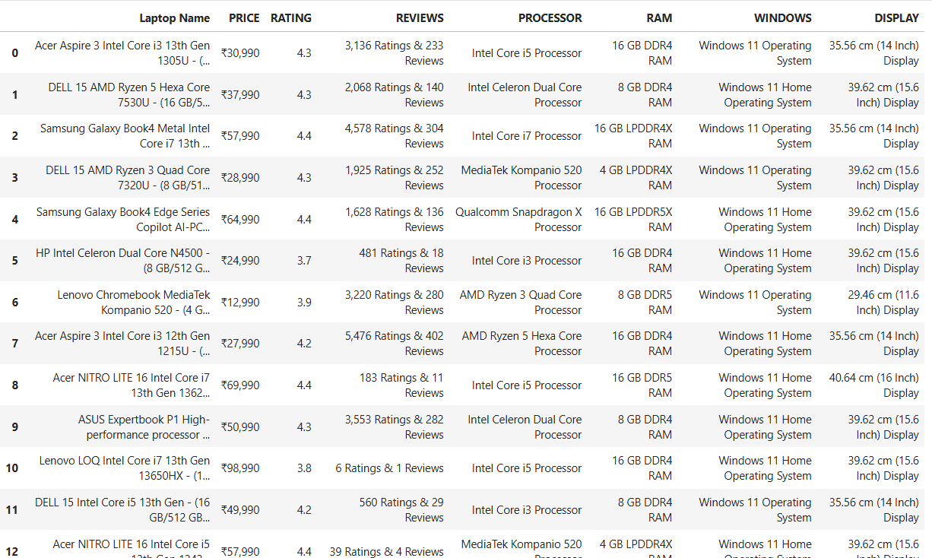
Data Before Cleaning:

Slide 6
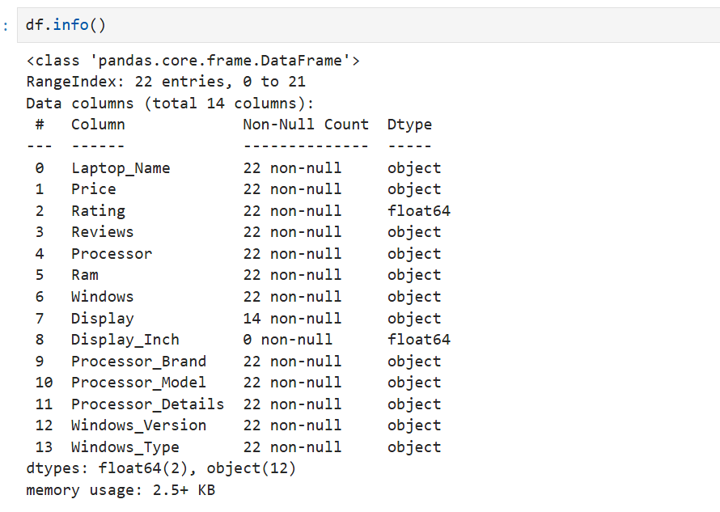
Data After Cleaning

Slide 7
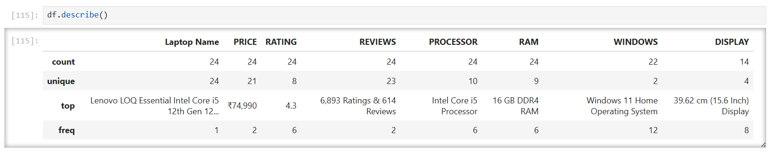
Statistics of Columns

Slide 8

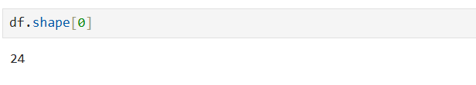
How many features(Columns) do you have?
How many observations(rows) do you have?

Slide 9
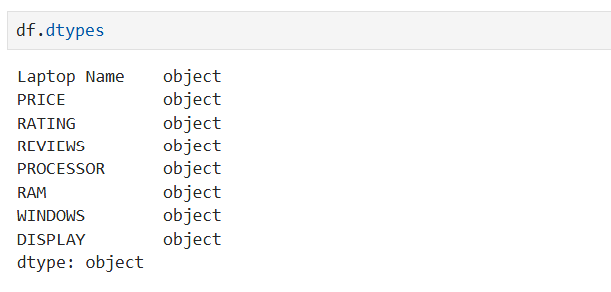
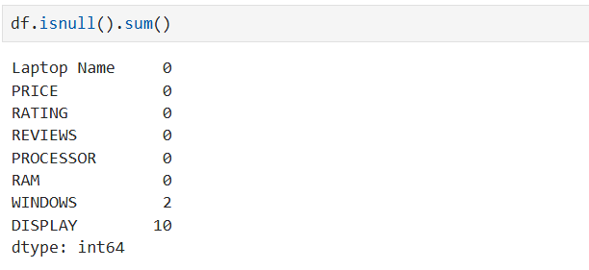
What is the data type of each feature(Columns)?
How many missing values are there?

Slide 10
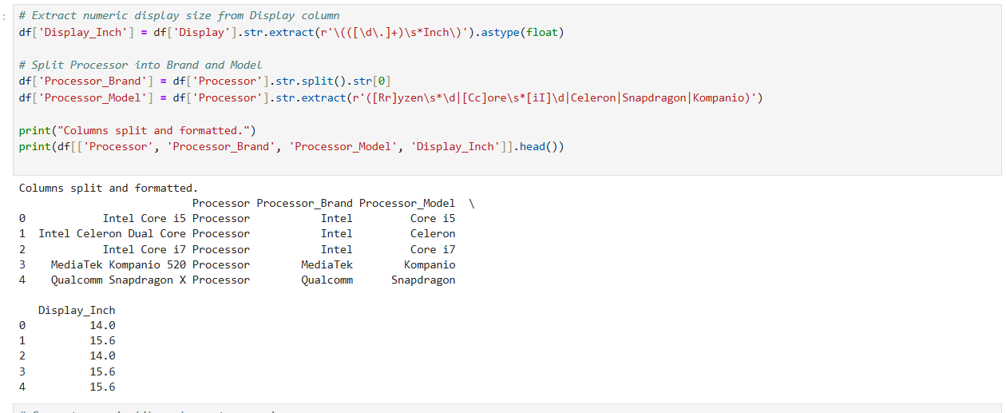
Extracting more columns

Slide 11
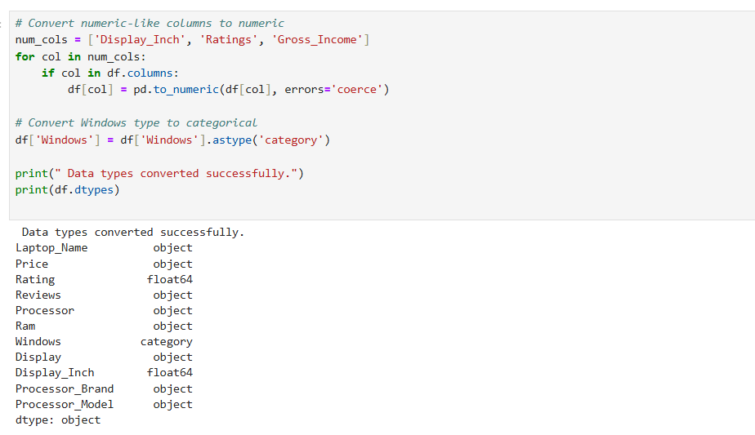
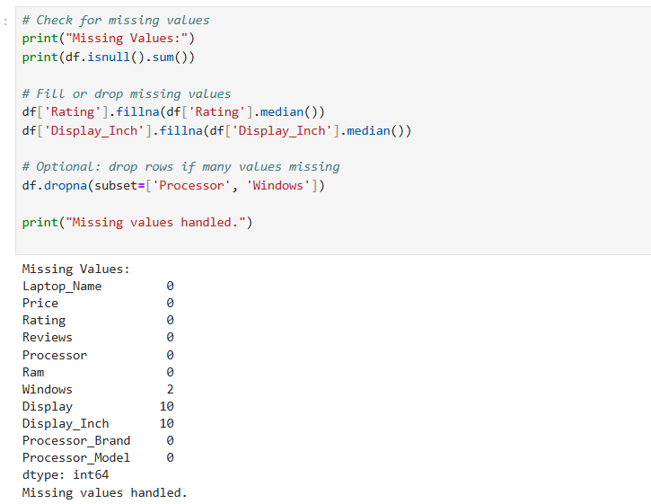
Data types and Missing values

Slide 12
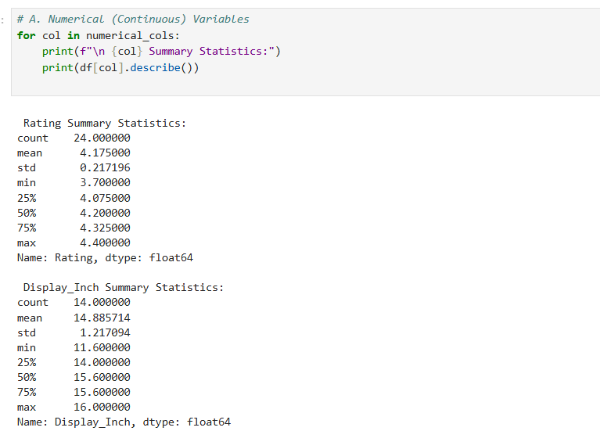
Statistical Summary of Univariate Analysis

Slide 13
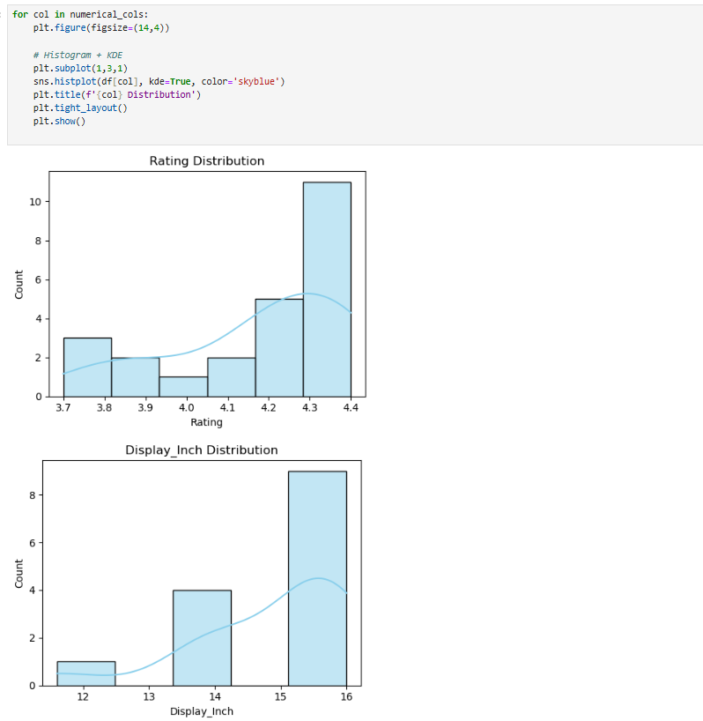
Univariate Analysis

Slide 14
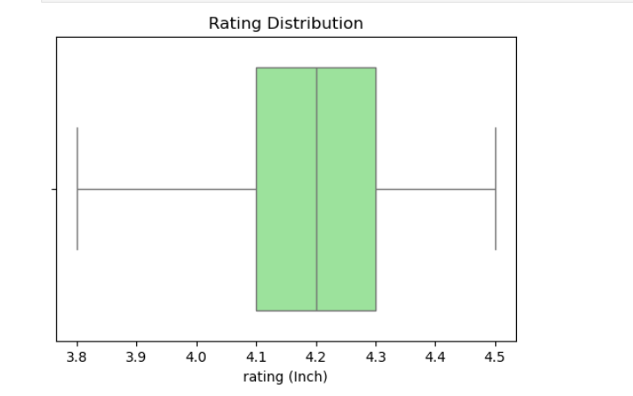
Box plot (Numerical columns)

Slide 15
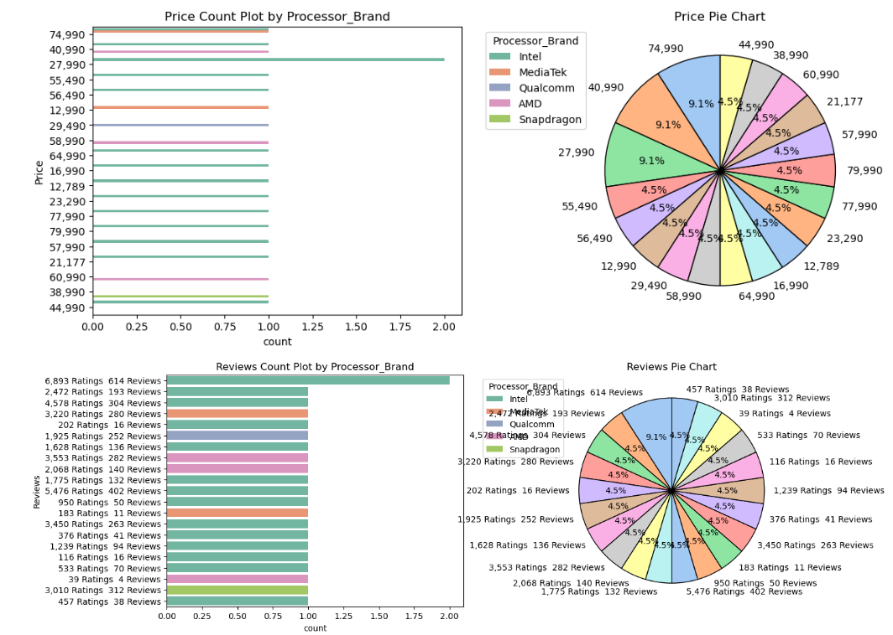
Categorical Columns

Slide 16
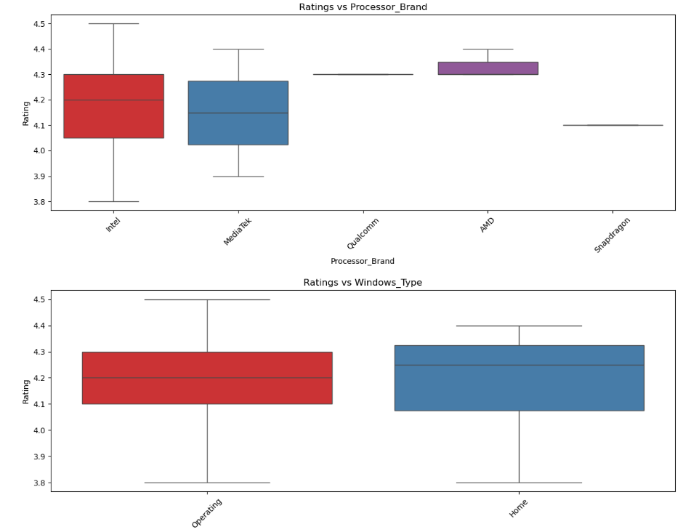
Bivariate Analysis

Slide 17
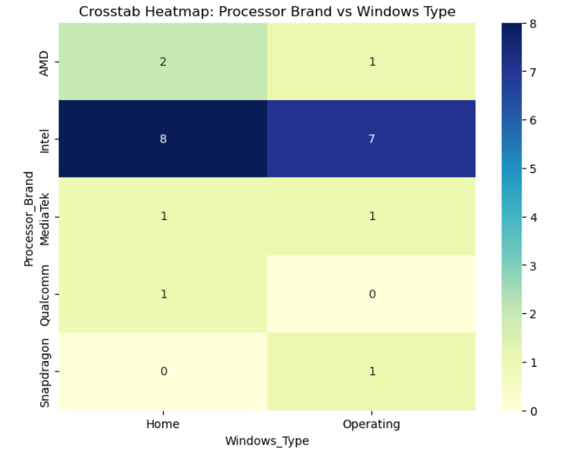
Heat map

Slide 18
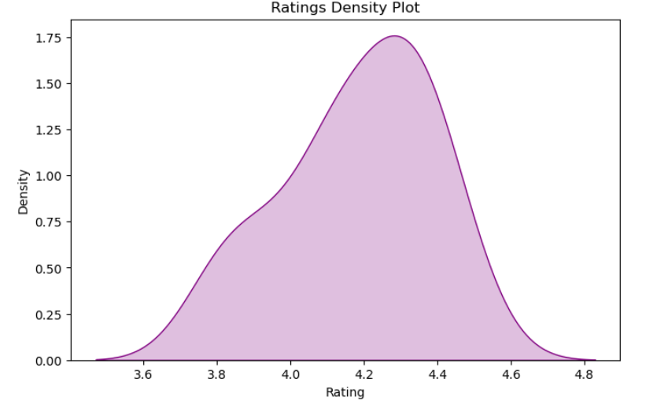
KDE Plot

Slide 19
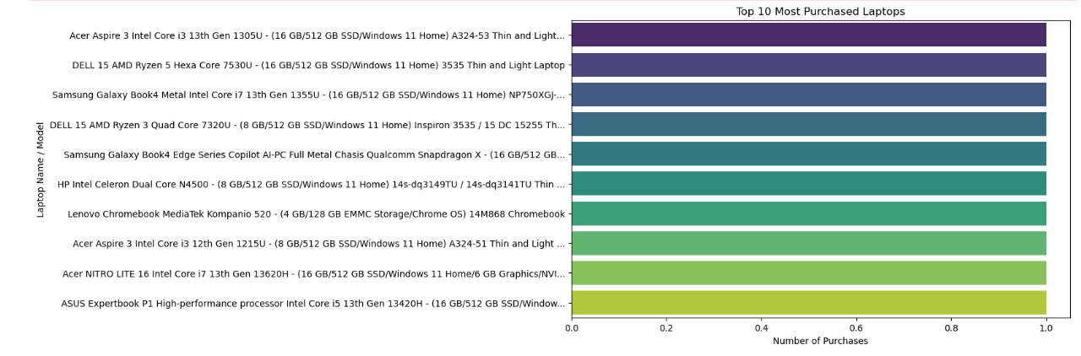
Top 10 Most Purchased Laptops

Slide 20
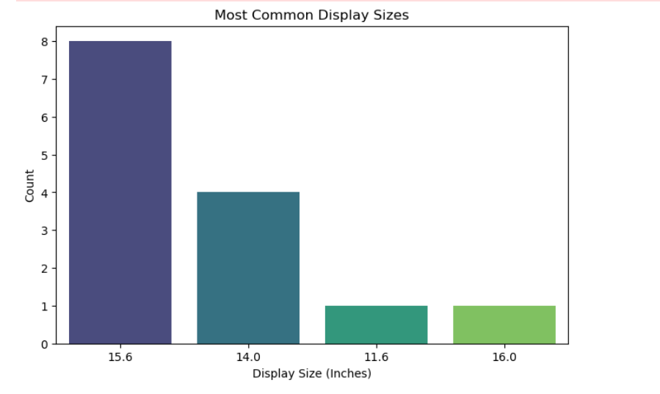
Most Common Display Sizes

Slide 21
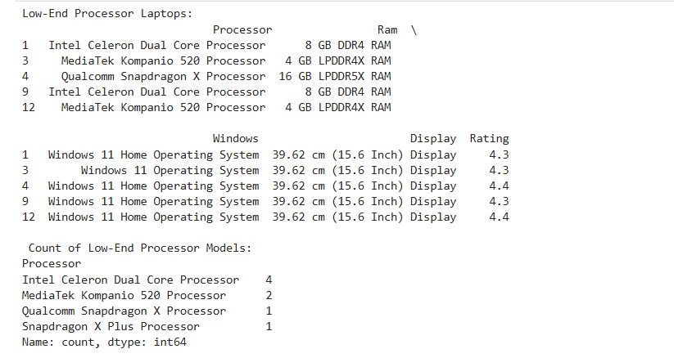
Low End Processors

Slide 22
OBSERVATIONS
Central Tendency:
Average rating across laptops: ~4.3
Dispersion: ratings are tightly distributed between 4.0 and 4.8.
Categorical Insights: Windows 11 Home is the most common OS type.
Most laptops in the dataset are equipped with Intel processors, followed by AMD, indicating Intel’s dominance in the market.
15.6-inch displays are the most common size, suggesting a balance between portability and usability.
Lower-end processors like Celeron contributed less revenue.

Slide 23
Conclusion
This project involved web scraping and exploratory data analysis (EDA) on a laptop dataset to understand market trends, product performance, and customer preferences. After cleaning the data and performing detailed univariate and bivariate analyses, it was observed that most laptops feature Intel processors, Windows 11 Home OS, and 15.6-inch displays, reflecting mainstream consumer demand. The average customer rating was above 4.2, indicating overall high satisfaction. Premium configurations such as Intel i7 and AMD Ryzen 7 models showed higher ratings and generated greater gross income, while lower-end processors like Celeron contributed less revenue. The analysis also revealed that larger display models and higher RAM configurations positively influence both customer ratings and income. Overall, the EDA provided valuable insights into how specifications affect sales and user satisfaction, helping identify key factors that drive laptop performance and profitability.

Slide 24

THANK YOU

